Slide 1
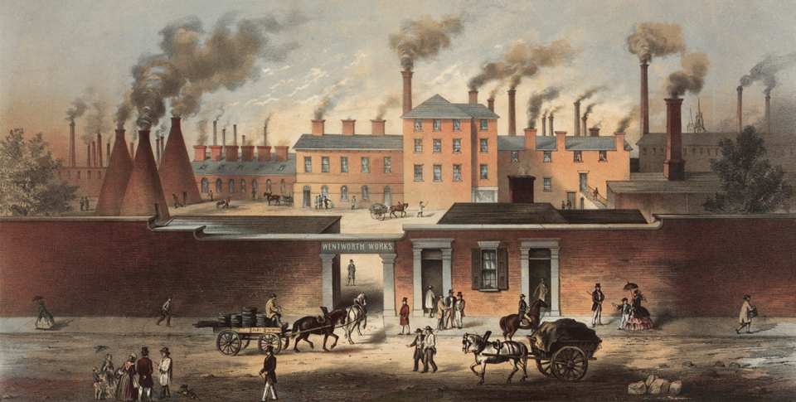
The Industrial Revolution (1750–1914)
Topic 7 Lesson 1 The Industrial Revolution Begins

Slide 2
The Industrial Revolution (1750–1914)
Topic 7 Lesson 1 The Industrial Revolution Begins
Learning Objectives
Describe how changes in agriculture helped spark the Industrial Revolution.
Analyze why the Industrial Revolution began in Britain.
Explain the role of steam technology and textile manufacturing in the Industrial Revolution.
Describe how the factory system and transportation revolution advanced industry.
Trace how the Industrial Revolution spread.

Slide 3
The Industrial Revolution (1750–1914)
Topic 7 Lesson 1 The Industrial Revolution Begins
Key Terms
Industrial Revolution.
anesthetic,
enclosure.
James Watt
smelt
Capital
enterprise
entrepreneur
putting-out system,
Eli Whitney
turnpikes,
Liverpool
Manchester,

Slide 4
New Ways of Working Change Life
A Rural Way of Life
In 1750 most people are living in villages, making their clothes, growing their own food. Very few travel
Growing Cities
With the start of the Industrial Revolution (IR) many villages will grow into cities
Industrialization Brings Great Change
Travel will be faster. A lot of scientific inventions and scientific first will be occurring. Examples: the use of anesthetic, first sewing machine, measuring the speed of light, use of antiseptic in childbirth, and the start of skyscrapers

Slide 5
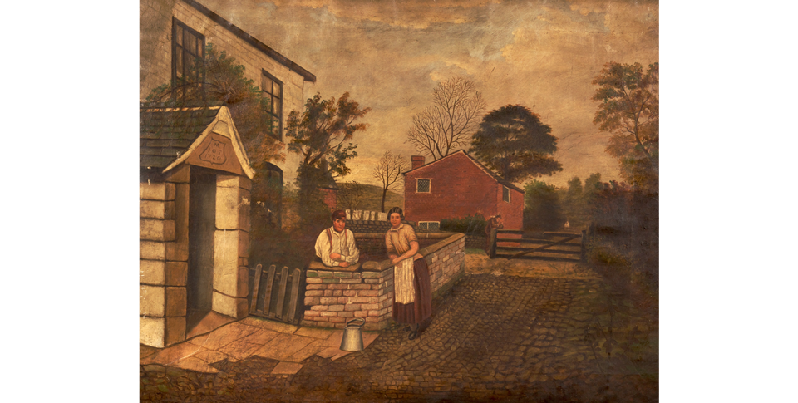
New Ways of Working Change Life
Before the Industrial Revolution, people lived mostly in small farming villages like this one in England. They grew their own food and wore clothes made by hand.

Slide 6
A New Agricultural Revolution
Farmers Reclaim Land and Renew Soil
Dutch lead the way with dikes to reclaim land from the sea, combine small fields into one large one and use fertilizer
British will use different soils to raise crop yields
Townshend will promote turnips to improve soil and Jethro Tull will invent the seed drill to place seeds in a row rather than scattered
Wealthy Landowners Enclose Lands
Landowners are going to take over lands held by peasants and consolidate them into larger areas to raise sheep or build farms
Farmers and other laborers will lose their jobs and move to cities to find work in factories
Population Grows Because of Better Farming
Combine more food with better hygiene from people leads to population growth

Slide 7
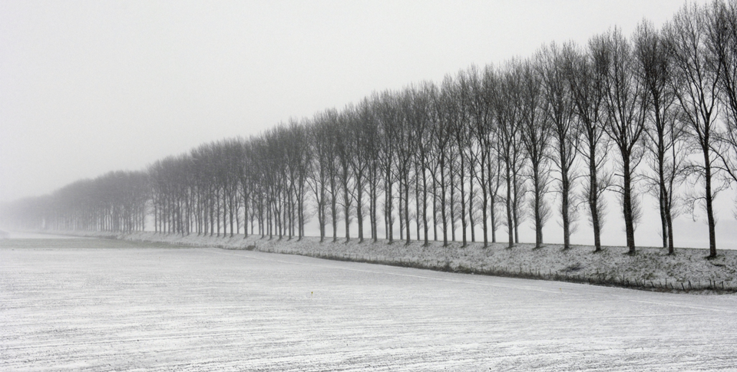
A New Agricultural Revolution
In a dike like this, a wall of mounded earth blocks the flow of water onto a field. Trees are planted on top of the dike because their roots help hold the dike together.

Slide 8
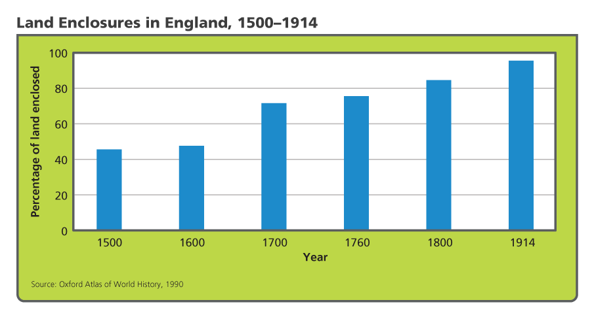
A New Agricultural Revolution
Analyze Graphs Between which years was the largest percentage of land enclosed? By 1914, what percentage of land remained unenclosed?

Slide 9
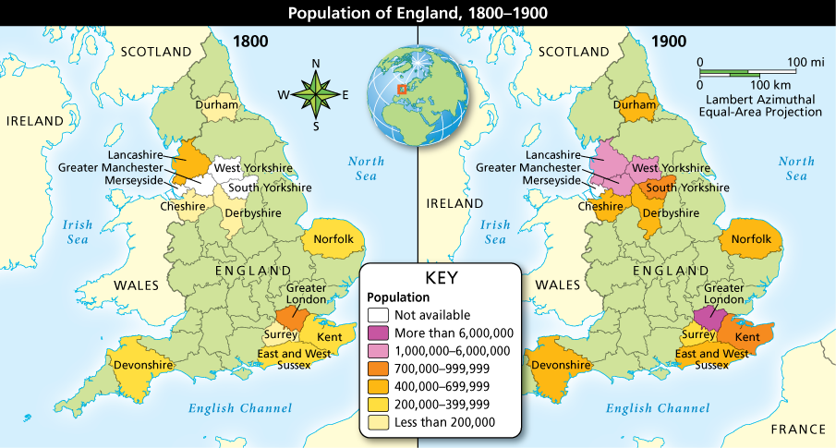
A New Agricultural Revolution
Analyze Maps Compare the populations of select counties of England in 1800 and 1900. Which counties had the largest population by 1900? Why might those counties have had high populations?

Slide 10
Coal, Steam, and the Energy Revolution
James Watt and the Steam Engine
1712 Thomas Newcomen developed a steam engine.
1764 James Watt improves on Thomas design to make it more efficient and it will later on power machines, trains, steamships
Producing Better Iron
1709 Abraham Darby will use coal instead of charcoal to smelt iron. This will produce less expensive and better-quality iron

Slide 11
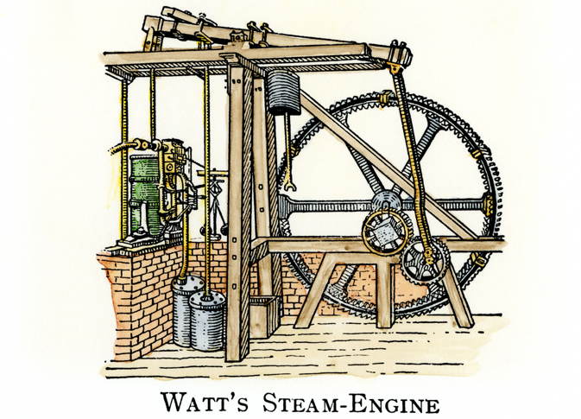
Coal, Steam, and the Energy Revolution
Watt’s engine used steam and atmospheric pressure to power pistons and rods that moved machinery. It had a separate condenser to keep the water hot, conserving energy.

Slide 12
Why Did the Industrial Revolution Start in Britain?
Natural Resources and Geography
Britain has lots of iron and coal to help build and fuel engines and machines. They also have a lot of ports and rivers to help with trade and provide water power
Labor and Capital
Britain will have more labor from the population boom and from the agricultural improvements that needed less workers
Capital will come from many different people who made money in overseas trade
Entrepreneurs and Inventors
Britain will have plenty of mechanics who will invent new things and entrepreneurs who will take risks
A Favorable Climate for Business
Britain has a stable govt. who supports growth and a strong navy to protect interests overseas. People supported new enterprises

Slide 13
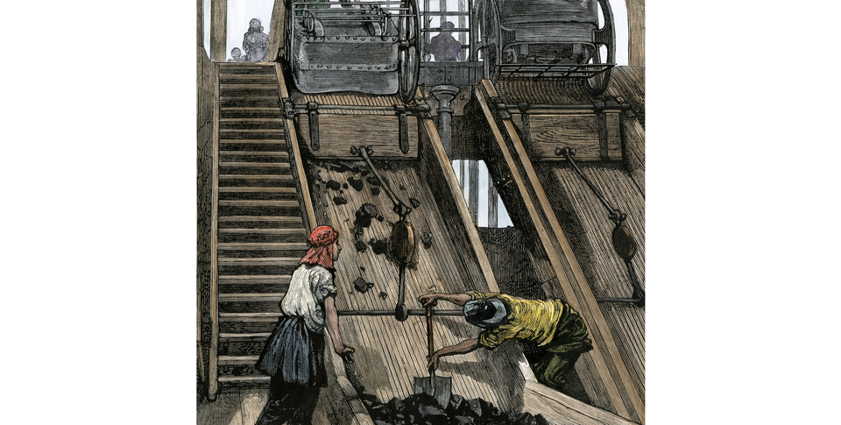
Why Did the Industrial Revolution Start in Britain?
Women work in a British mine to screen and sort coal coming from the mine. Coal was a plentiful natural resource in Britain and supplied fuel for steam engines.

Slide 14
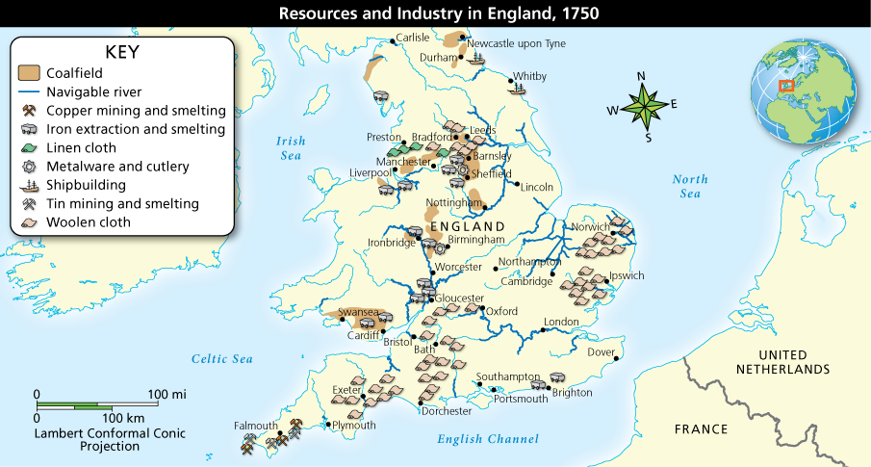
Why Did the Industrial Revolution Start in Britain?
Analyze Maps Notice where various resources and industries were located in 1750. Why is the location of navigable rivers important to resources and industry?

Slide 15
Textile Industry Initiates Industrialization
Technology Speeds Production
Manually operated machines for spinning and weaving took time, so inventors came up with ways to speed it up
John Kay’s Flying Shuttle enabled weavers to weave so fast that they outpaced spinners.
James Hargreaves solved the issue with the Spinning Jenny that spun many threads at the same time
Eli Whitney will invent the cotton gin in America to separate cotton seeds from raw cotton to increase production
The First Factories
They are much bigger machines than before, so they are stored in long shed or warehouses and are powered by water or steam
Spinners and weavers now would come to these factories to work
The amount of labor in one warehouse produced the same amount that the entire district used to do before

Slide 16
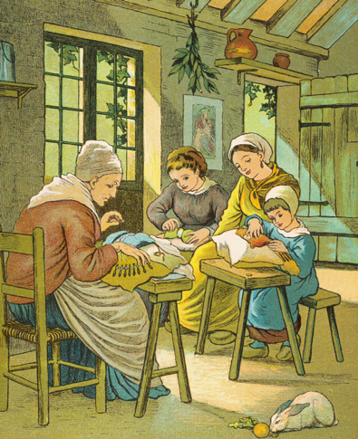
Textile Industry Initiates Industrialization
Generations of women made textiles at home as part of the putting-out system. These women are making lace. Make Predictions What impact do you think machines and industrialization will have on the putting-out system?

Slide 17
A Revolution in Transportation
Canals Improve Transportation
Late 1700’s, early 1800’s factories need efficient way to bring in resources and transport goods out. Canals are opened
Canals start being built but some are not profitable so they fail
Then locomotives become the way everyone moves materials
The Steam Locomotive Drives Railroads
Invention of the steam locomotive that makes railroads possible
World’s first major rail line opened in 1830 in England
By 1870 railroads were all over Europe and North America
Cheaper Goods Lead to More Demand
As more goods were made by machines the price of the goods fell
As the prices fell more people bought goods
This will lead to more demand for goods

Slide 18
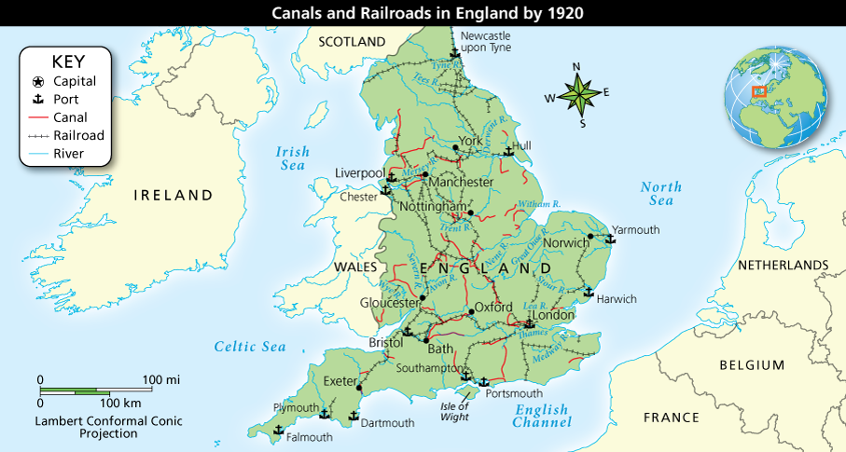
A Revolution in Transportation
Analyze Maps Improved transportation methods, such as canals and railroads, moved goods to market faster. Based on the map, what advantage did railroads offer industry?

Slide 19
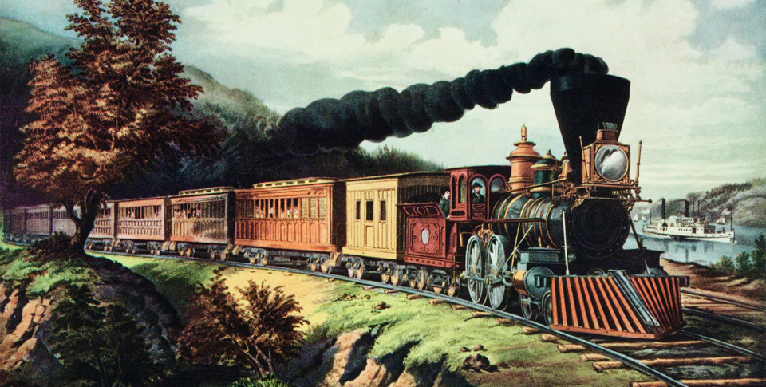
A Revolution in Transportation
Steam locomotives made travel faster than ever before. The locomotives burned coal to produce steam and traveled overland routes on iron rails.

Slide 20
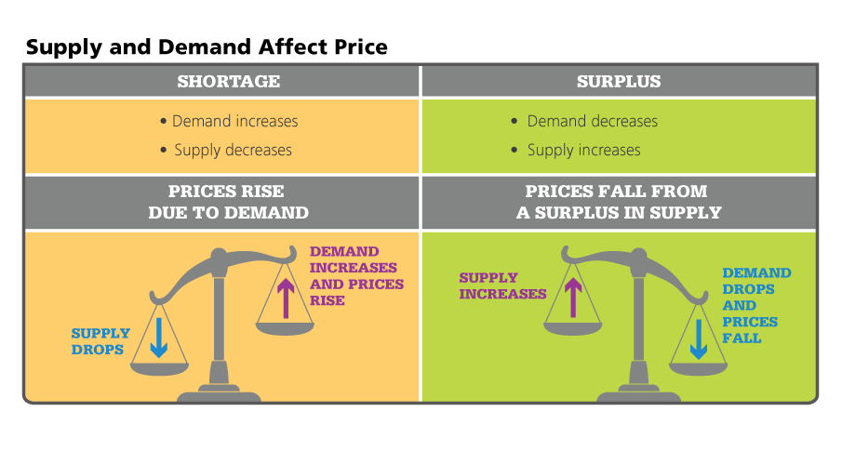
A Revolution in Transportation
Analyze Charts Demand and supply move in opposite directions. Why does an increase in demand cause prices to rise?

Slide 21
Industrialization Spreads
Other Nations Industrialize
At first Britain is the world’s industrial giant
Then Belgium starts to industrialize when a British mechanic opens up a factory
By the mid 1800’s other countries are catching up
Germany will unite and become the leading industrial power in Europe. Large amount of resources in Germany will help
America will become the world’s industrial giant
Industry Spreads Unevenly
Eastern and Southern Europe will develop more slowly because of a lack of resources. Russia will have resources but have political problems. Japan will industrialize rapidly because of their govt.
Social, Economic, and Political Changes
All this will bring many changes. At first people will be exploited in factories but will fight back. Politics will change to meet the demands of society. Western powers will dominate world affairs

Slide 22
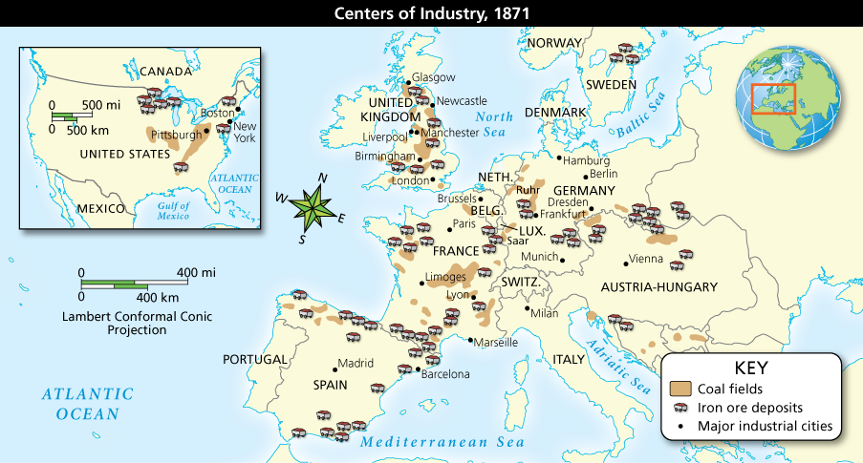
Industrialization Spreads
Analyze Maps By 1871, industrialization had spread through Europe and across the Atlantic to America. Which major industrial cities were probably shipping centers as well? Identify two nations that were at a disadvantage for industrialization.

Slide 23
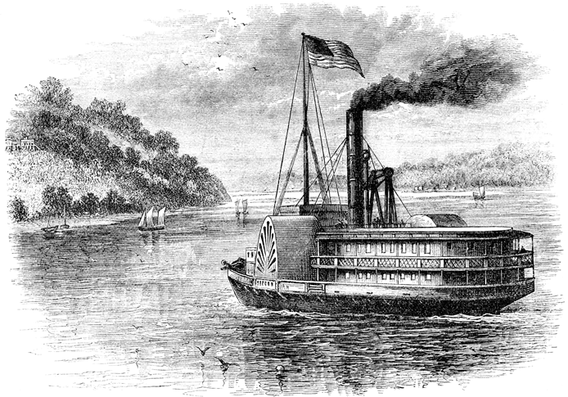
Industrialization Spreads
This paddle steamer traveled the Potomac River in the United States around 1860. River travel was slow before steam engines because boats relied on sails or water currents. Steamers revolutionized water travel.

Slide 24
Quiz: New Ways of Working Change Life
Which of the following is one main reason the Industrial Revolution was a turning point in world history?
A. People no longer needed to travel on foot or in horse-drawn carts.
B. The traditional rural lifestyle ended for most people.
C. Anesthetics became available for use in dentistry and surgery.
D. People stopped exchanging goods in outdoor markets.

Slide 25
Quiz: A New Agricultural Revolution
Why did the population of Britain increase in the mid-1700s?
A. Better farming led to a food surplus, so fewer people died of starvation.
B. People moved to cities from farming villages to find employment.
C. More people were needed to work in factories on the new machines.
D. Population statistics clearly show that people were healthier.

Slide 26
Quiz: Coal, Steam, and the Energy Revolution
What important contribution did James Watt make to the Industrial Revolution?
A. He developed a seed drill for planting.
B. He developed ways to increase crop yields.
C. He improved methods of iron smelting.
D. He perfected a new source of energy.

Slide 27
Quiz: Why Did the Industrial Revolution Start in Britain?
Who supplied the capital that helped Britain industrialize?
A. the British government
B. investors willing to take risks
C. the rapidly growing labor force
D. talented inventors with new ideas

Slide 28
Quiz: Textile Industry Initiates Industrialization
Which sequence of events best describes the role of textile manufacturing in initiating industrialization?
A. Demand for cotton cloth grew, cottage industry developed, machines replaced cottage industry, and early shed factories developed.
B. The flying shuttle was developed, demand increased for a faster weaving machine, the spinning jenny was developed, and cottage industry boomed.
C. Demand for cotton grew after new machines produced cloth faster, cottage workers had difficulty keeping up, and the textile industry was consolidated into factories.
D. India demanded more cotton textiles, inventors created new spinning and weaving machines, and factories were built to house those machines.

Slide 29
Quiz: A Revolution in Transportation
Which statement best explains how transportation technology advanced the Industrial Revolution?
A. Technological improvements in the shipping industry led most industries to transport their goods to markets overseas.
B. Railroads allowed goods to travel over land, but shipping by sea remained the most important method of transporting goods.
C. Transportation spurred industry because rivers, ports, canals, and railroads aided the shipment of goods to many places.
D. Transportation played little role in industrialization until the arrival of railroads and the ability to move goods over land.

Slide 30
Quiz: Industrialization Spreads
What statement best describes the industrialization of other western nations after Britain?
A. Some nations learned about the new technology and had more resources than Britain so they could advance quickly by following Britain's lead.
B. Most other nations were slow to adopt industrialization practices because they were unaware of the benefits and had little contact with Britain.
C. Inventors from Britain shared their knowledge with Europe and the United States so that they could become trading partners with Britain.
D. Because all nations had equal access to factors of production, they quickly copied Britain's model and became industrialized.

